Slide 1
MATHEMATICS Statistics

Slide 2
General technology
Mean
Median
Mode

Slide 3
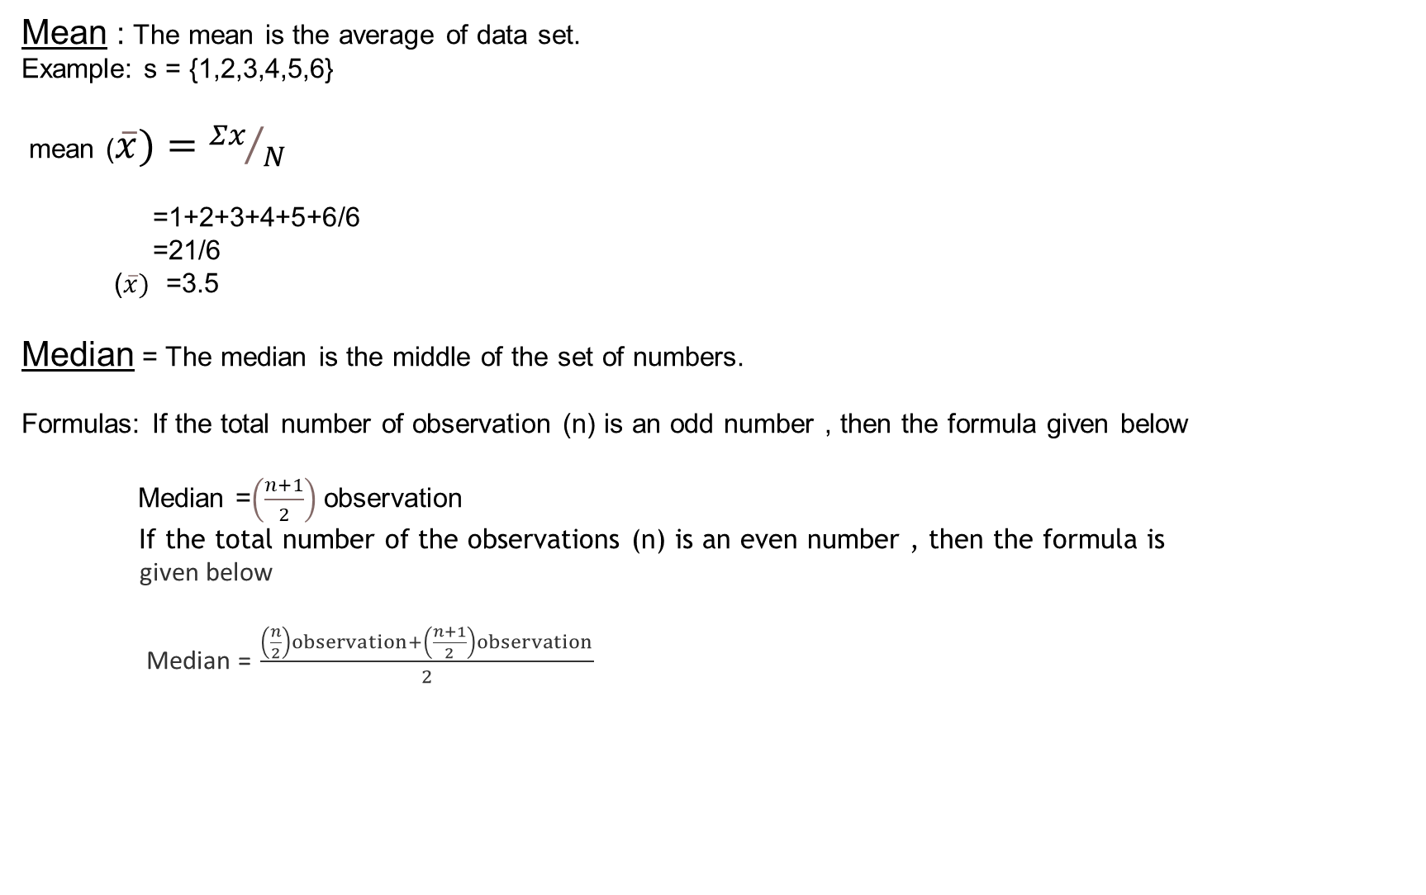

Slide 4
)
Example: p = {3,7,14,11,17,17,21}
Median (p)=3+7+11+14+17+17+21
odd(n) = (7+1)/2
=8/2
=4
even(n) = (7/2)+(7+1/2)/2
=3.5+4/2
=7.5/2
=3.75
Mode: The mode is the number that is repeated more than any other.
Formula: l + ( f1−f0) × h
(2f1−f0−f2 )
Example: Find the mode of the given data set
t = {3,3,6,9,15,15,15,27,27,37,48}
15 is the mode since it is appearing more number of times in the set
compared to other number.

Slide 5
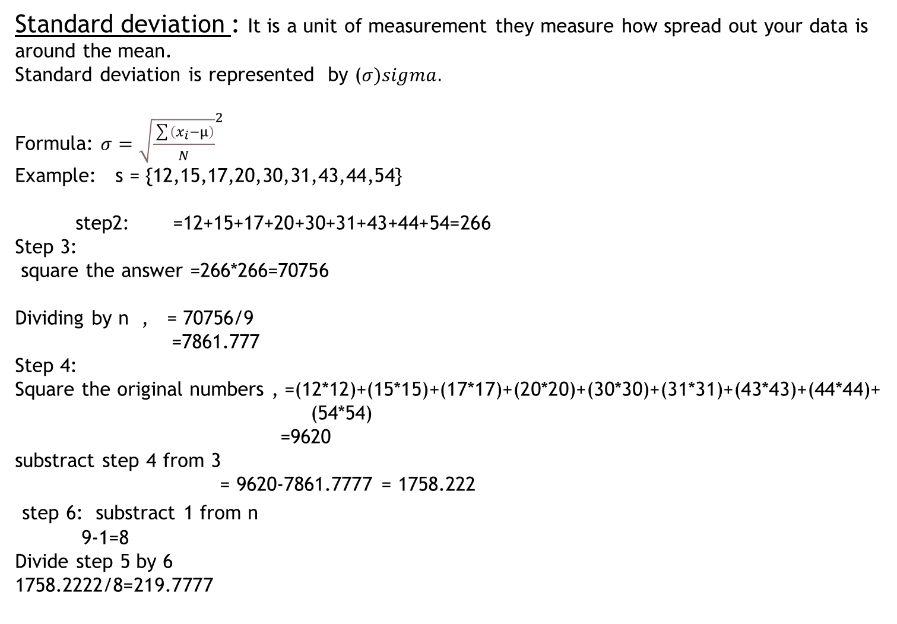

Slide 6
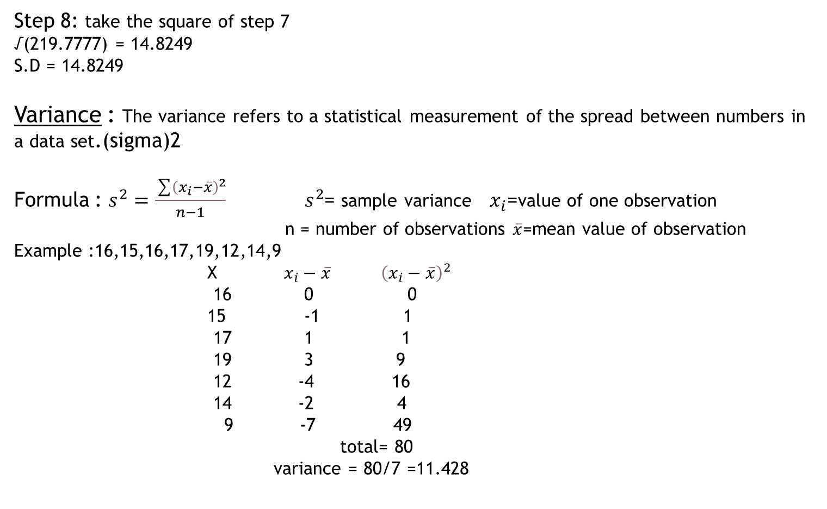

Slide 7
Population :It includes all the elements from the data set and measurable characterstic of the population such as mean and standard deviation are known as parameter . For example All people living in india indicates the population of india.
Types of population:
1)Finite population
2)Infinite population
3)Existant population
Sample : It includes one or more observation that are drawn from the population and the measurable characterstic of a sample is a static. Sampling is the process of selecting the sample from the population .
Basically there are two type of sampling
1)Probability sampling
2)Non-probability sampling

